Slide 1
ADVANCE YOUR CAREER
Professional Recognition from the IMI

Slide 2
The IMI
Who they are:
A Professional Body for individuals working in the automotive sector
An Awarding Organisation and End Point Assessment Organisation focused on automotive
What they do:
Support individuals working in the sector through professional membership and professional recognition
Provide consumer reassurance through a public facing Professional Register
Maintain educational standards
Assess and accredit the competence of individuals to operate in the sector
Develop individuals and further their careers
Campaign and build public confidence in the sector

Slide 3
Membership and IMI TechSafe
What is it?
Professional recognition that you can gain and display with pride as a member of the IMI furthering your career development
Proof that you stay current with emerging and safety-critical vehicle technologies
Supports compliance with UK and international government regulations and insurance requirements and giving you a voice to impact change
Customer confidence builder in your capabilities and professional commitment
A community of like-minded individuals who hold similar views, skills and expertise

Slide 4
Your path to IMI TechSafe recognition
Gain eligibility Achieve an IMI TechSafe eligible qualification or accredited assessment
Become a member Opt-in to join IMI membership, agree the IMI Professional Standard and gain access to IMI TechSafe recognition and professional registration
Retain your membership and IMI TechSafe recognition by completing relevant CPD over a three year cycle

Slide 5
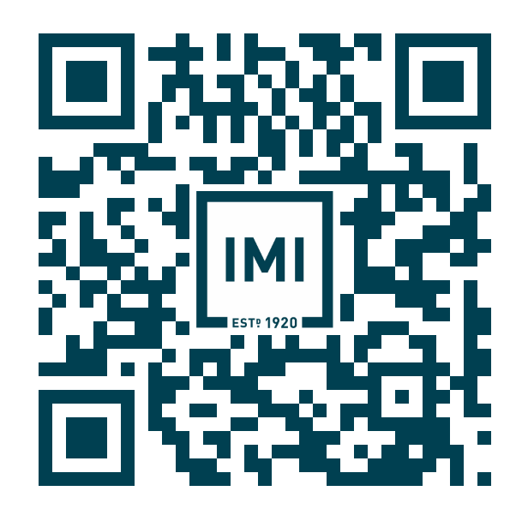
Scan to start your IMI membership journey

