Slide 2
What Is the Criteria for an
Inspiring Automotive Woman?

Slide 3
An Inspiring Automotive Woman is:
An inclusive leader
Driving organisational change to make the culture more inclusive
Helping to promote the company as an employer of choice for women
Undertaking school outreach or helping to reach out to fresh talent pools
Establishing or leading an Employee Resource Group or women's network
Mentoring or coaching female colleagues
Creating solutions and policies to help women to thrive in the workplace
Being a visible female automotive influencer / spokesperson in the media
Raising awareness of intersectionality and underrepresented female groups
Being an inspirational female role model
Inspiring you or her peers to create an inclusive culture
Driving change to ensure we serve female customers better

Slide 4
What Should the LinkedIn
Post Look Like ?

Slide 5
Use this template if you have permission to use a photo of your Inspiring Automotive Woman

Slide 6
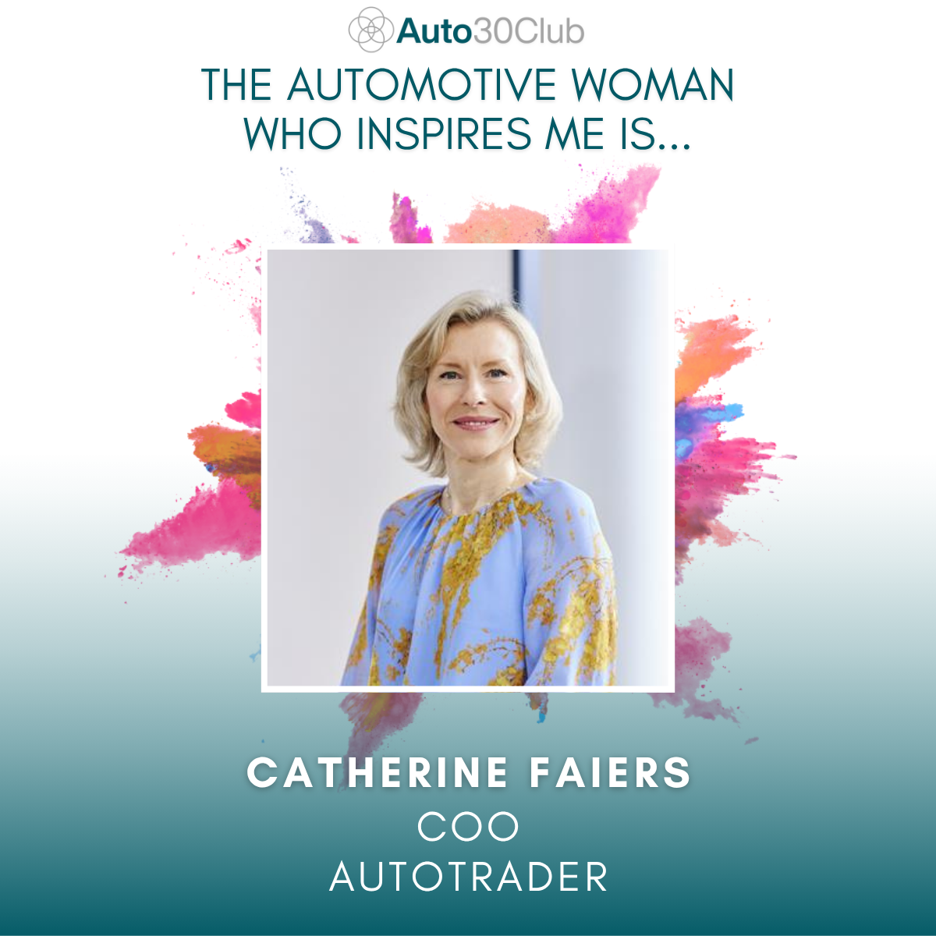
Here is an example, showing an image of Catherine Faiers, our 2025 overall Inspiring Automotive Woman of the Year

Slide 7
Use this template if you do not have permission to use a photo of your Inspiring Automotive Woman.
Insert her name via a text box across
the grey ribbon.

Slide 8
Here is an example using the
name of Catherine Faiers.

Slide 9
The text of your LinkedIn post should start with:
“The automotive woman who inspires me is {NAME} because…..………………………………{insert reason}
The text of your LinkedIn post should end with:
“That is why {NAME} is an #InspiringAutomotiveWoman.
So, #WhoInspiresYou ?”

Slide 10
"The automotive woman who inspires me is Catherine Faiers
An amazing leader with huge capacity to manage the big things whilst not forgetting about the detail which can have a profound impact on people. Someone who cares passionately about doing the right thing, for her people, the business and the industry. Unafraid to break down barriers, tackle the tricky topics which others may avoid, and make a stance. Her endless ability to be across so many areas simultaneously quite simply means progress is made!
A wonderful role model to many. At Auto Trader, we regularly see Catherine showing up, sharing personal stories from having children, juggling work and home life, career progression and dealing with challenging situations of all varieties. She is open, honest, sincere and comfortable being vulnerable with others. As a result she not only has a great impact on people in the organisation but touches the hearts of colleagues which is endearing. Catherine spends time engaging with our employee networks and does her utmost to listen and learn from our people, openly challenging her own thinking.
Her commercial acumen and strategic thinking is hard to summarise. Those who know her have huge respect and admiration for her business capabilities again across all levels from shaping the future strategy of a FTSE100 tech business like ours to driving the successful delivery of our operations. She’s a driven individual with an abundance of talent rarely seen! Catherine is a superb role model to many internally and also externally be that in automotive or beyond. She has recently been instrumental in bringing together collectives of women at all levels in the interest of offering support and lifting others. She’s also a wonderful role model to her children and often shares photos and insight be that school plays, driving tractors or anything else a typical mum gets happily involved in!
In summary, an exceptional organisational and industry inspirational leader who we’re proud is ours. ❤️
That is why Catherine Faiers is hashtag#InspiringAutomotiveWoman.
So,#WhoInspiresYou?

Slide 11
How To Make Your Own Post
1. Download the template you wish to use, and add the photo and/or name of the woman you are nominating.
2. Export your now personalised PPT slide as a PNG or JPEG image so that LinkedIn recognises it as a photo.
3. On your LinkedIn page, you will see a section at the top of your feed labelled “Start a post”.
4. Click on this statement and write what you want to say about your Inspiring Automotive Woman, and use the hashtags and opening and closing phrases.
5. Remember to tag our @Auto30Club showcase page.
6. Click on the “photo” icon on the bottom left to upload your image
of your personalised slide.

Slide 12
Who Can Create the LinkedIn Post?
You as an individual on your personal LinkedIn account.
The company's marketing or social media team can ask colleagues to submit their content for posting through the company's LinkedIn account, crediting the colleague with the nomination.
(Note, however, that a personal nomination from a colleague tends to have a more positive impact than a corporate one).

Slide 13
When Should I Post the Nomination
On LinkedIn?
From 09.00 on Monday July 7th to 15.00 Friday July 11th

Slide 14
We will launch the campaign with a post at 08:45 on Monday, July 7th, encouraging everyone to nominate a woman who inspires them, so she can have the chance to be a 2026 winner.
You can post any time from 09.00 on Monday, July 7th, to 15.00 on Friday, July 11th
Note that the best times for your post are early morning, lunchtime and before 15.00, Monday to Thursday.
If you are naming more than one woman, please space them throughout the week, starting on Monday, rather than all on the same day, or all later in the week.
Remember to tag us and also your company so that others will see it
You can schedule your post in advance by clicking on the clock icon on the bottom left of the post

Slide 15
How Will The Winners
Be Selected?

Slide 16
Every post that features the hashtags #InspiringAutomotiveWoman or #WhoInspiresYou and tags the Auto30Club LinkedIn showcase page will be reacted to by our page and added to a tracking list of nominations. If the woman receives multiple nominations, all will be included.
Each nomination will be assessed based on how well it meets the criteria for an Inspiring Automotive Woman.
A shortlist of at least 30 women will be selected and celebrated on LinkedIn.
Their nominators and companies will be approached to provide more detailed information.
The most Inspiring Automotive Women will be named as IAW Award winners of 2026 in January and also shortlisted for the IAW of the Year Award, and the overall IAW of the Year will be announced at the IMI Awards Dinner in March.

Slide 17
How Will The Winners
Receive Their Awards?

Slide 18
The Inspiring Automotive Women Award winners of 2026 will be invited to the IMI Awards Dinner in March to receive their awards at a private reception.
Each winner will receive a complimentary ticket to the dinner, and their companies will be encouraged to buy further tickets to the dinner for colleagues and friends to see them receive their award at the private reception
The winners will be revealed at the dinner as the shortlist for the Auto30Club IAW of the Year Award
Julia Muir will present the overall IAW of the Year winner with her award during the main IMI Awards ceremony

Slide 19
Let’s hit over 500
nominations this year!

